Slide 1
Autostart program in Windows

Slide 2
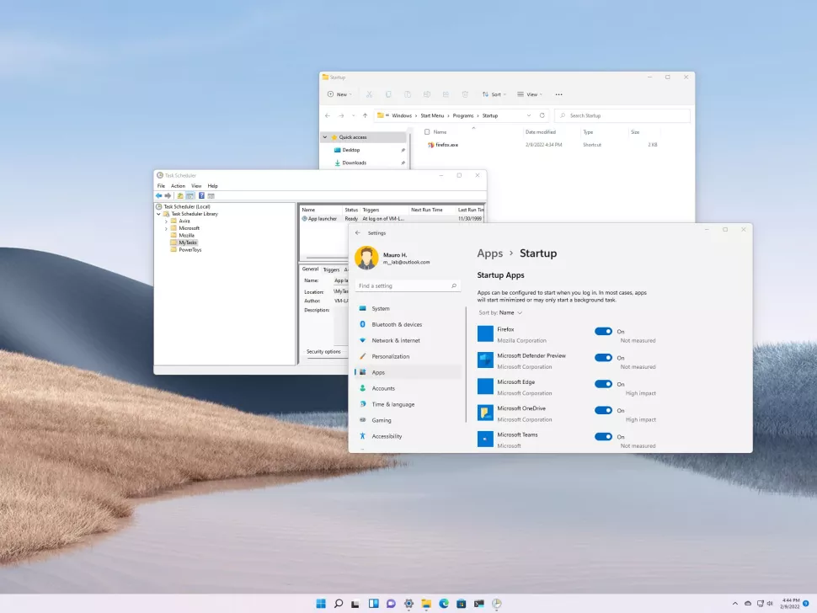
How to launch apps automatically during startup on Windows 11
Windows 11 offers multiple ways to launch apps automatically on startup, and in this guide, we'll show you how.

Slide 3
If you have a group of apps you open immediately every time you sign into your Windows 11 account, it's possible to configure these applications to launch automatically to save extra steps and get to them faster.
You have at least four ways to auto-start an app on Windows 11. If the app can start automatically by design, you can control this behavior from the "Startup" settings page or the app's preference page. In addition, you can place a shortcut in the "Startup" folder, which the system will detect and run to launch the program automatically, or you can create a task to launch the app automatically as the user logs in.
In this Windows 11 guide, we will walk you through the different ways to launch apps automatically on your computer.

Slide 4
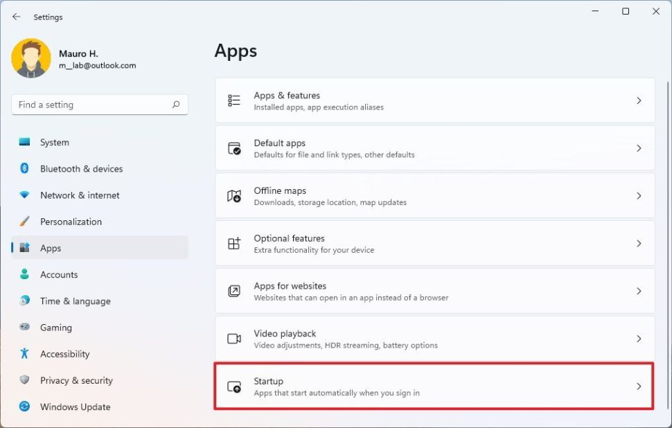
How to configure app automatic start with Startup settings
To launch an app startup on Windows 11, use these steps:
1.Open Settings.
2.Click on Apps.
3.Click the Startup page on the right side.

Slide 5
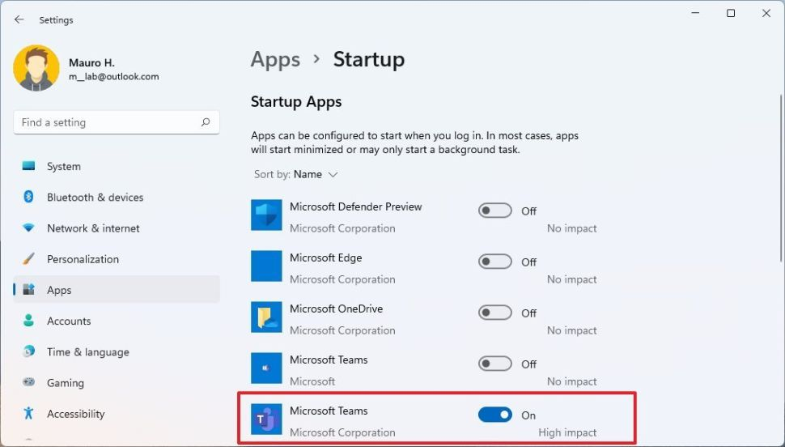
4.Turn on the toggle switch for the app you want to launch at startup.
Once you complete the steps, the app will start as you sign into the account automatically. You may need to repeat the steps to configure other apps.

Slide 6
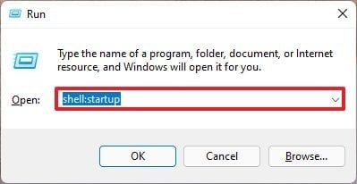
How to configure app automatic start with Startup folder
Windows 11 also includes the "Startup" folder, a known folder that the system checks every time you sign in and run any app or script found in the location. If the app you want isn't available through the Settings app, you can place a shortcut to launch automatically on startup.
To start an app automatically through the Startup folder, use these steps:
1.Open Start.
2. for Run and click the top result to launch the tool.
3.Type the following command and click the OK button.shell:startup

Slide 7
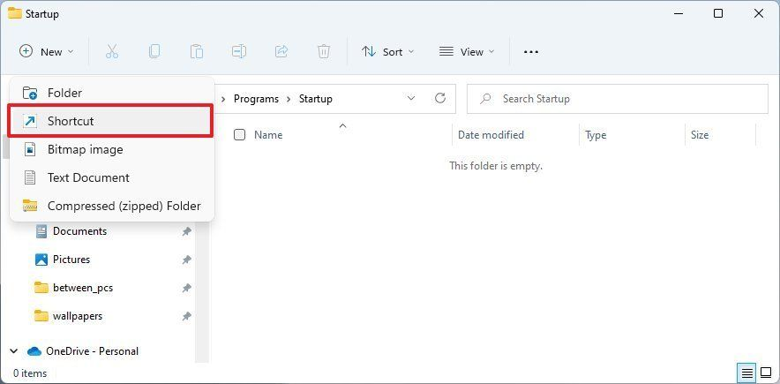
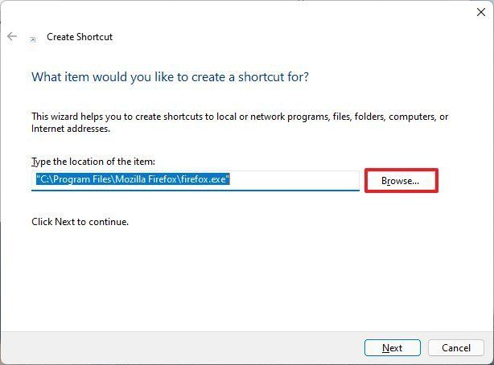
4.Click the New menu and select the Shortcut option.
5.Click the Browse button.

Slide 8
6.Open the app installation folder.Quick tip: Classic 32-bit applications are usually installed in the "Program Files (x86)" folder, and 64-bit applications are typically installed in the "Programs Files" folder.
7.Select the app executable (.exe) file that launches the program.Quick note: Usually, the exe file has the name (or part of the name) and the icon of the program. For instance, the "Mozilla Firefox" executable file is the "firefox.exe" file.
8.Click the OK button.
9.Click the Next button.
10.Click the Finish button.
After you complete the steps, Windows 11 will launch any app, shortcut, or script that it finds in the Startup folder.

Slide 9
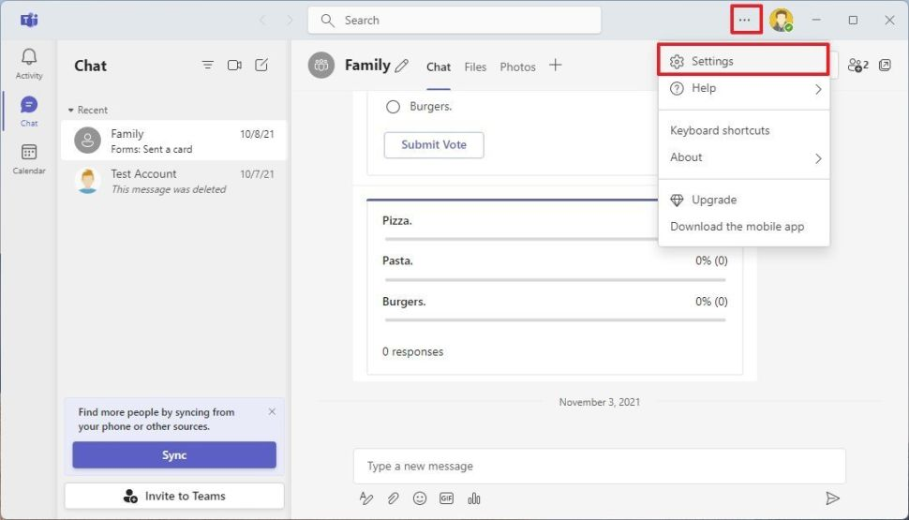
How to configure app automatic start with app preferences
You may also be able to configure an app to launch at startup from the app's settings. Here's an example to enable Microsoft Teams (consumer) to launch at startup automatically:
Open the Microsoft Teams app.
Click the Settings and more (three-dotted) menu.
Select the Settings option.

Slide 10
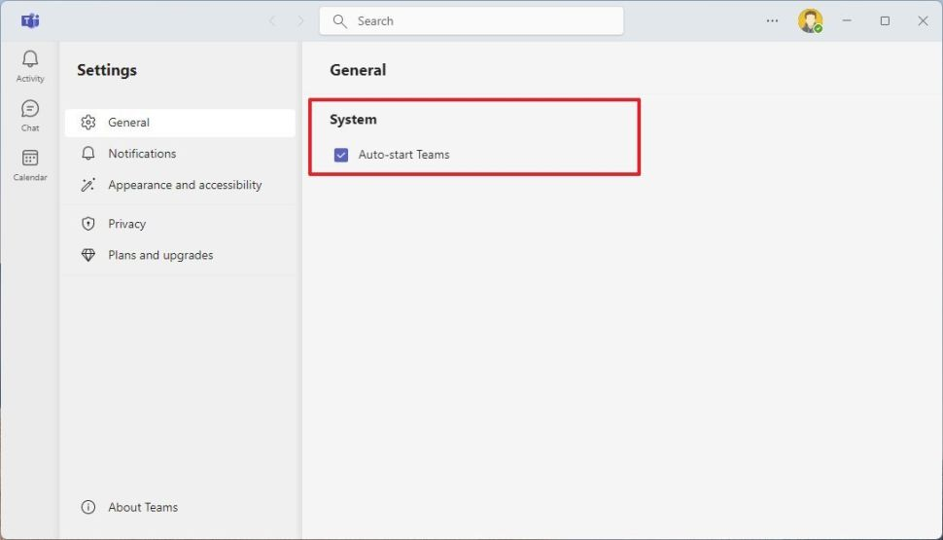
Click on General.
Check the Auto-start Teams option.
Once you complete the steps, the app will launch automatically at startup. Although these steps are specific to the consumer version of Microsoft Teams, the concept applies to most classic desktop programs.

Slide 11
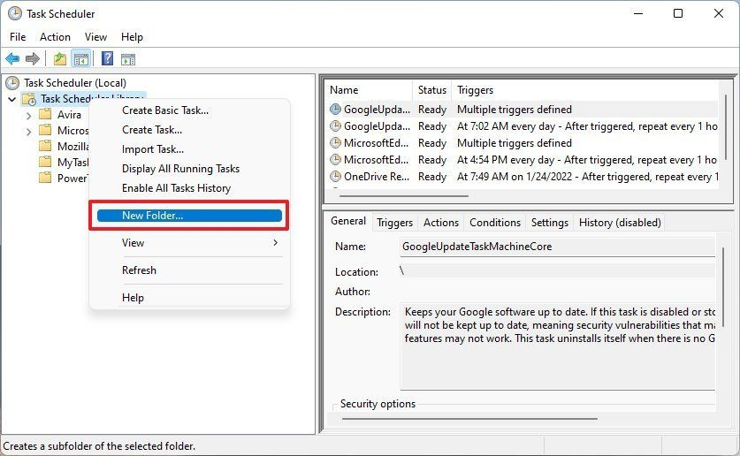
How to configure app automatic start with Task Scheduler
Alternatively, it's also possible to run apps during startup by creating a scheduled task using the Task Scheduler app.
To auto-start apps on Windows 11 with Task Scheduler, use these steps:
Open Start.
Search Task Scheduler and click the top result to open the app.
Right-click the "Task Scheduler Library" branch, and select the New Folder option.

Slide 12
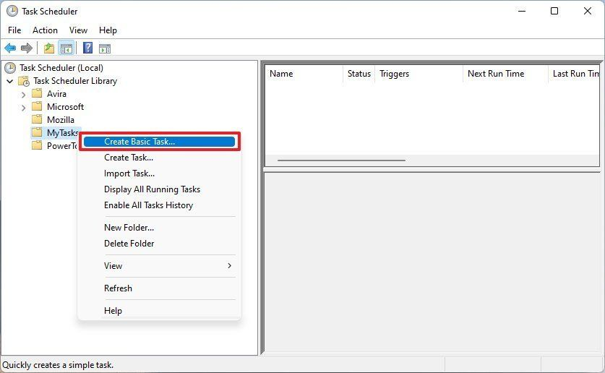
Type a name for the folder — for example, MyTasks.Quick note: This step isn't a requirement, but it's a recommended step to keep your tasks separate from the system and apps tasks.
Click the OK button.
Expand the "Task Scheduler Library" branch, and select the MyTasks folder.
Click the Action menu.
Select the Create Basic Task option.

Slide 13
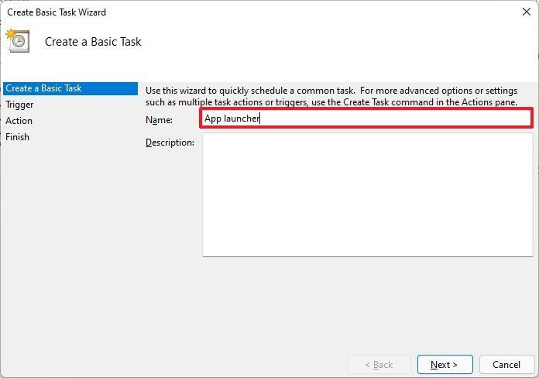
Confirm a name for the task.
Task name setting
Source: Windows Central (Image credit: Source: Windows Central)
(Optional) In the "Description" field, create a description for the task.
Click the Next button.
Select the When I log on option.Quick tip: You could select the "When the computer starts" option, but it might require changing the "Security options" in the advanced properties of the task to work correctly.

Slide 14
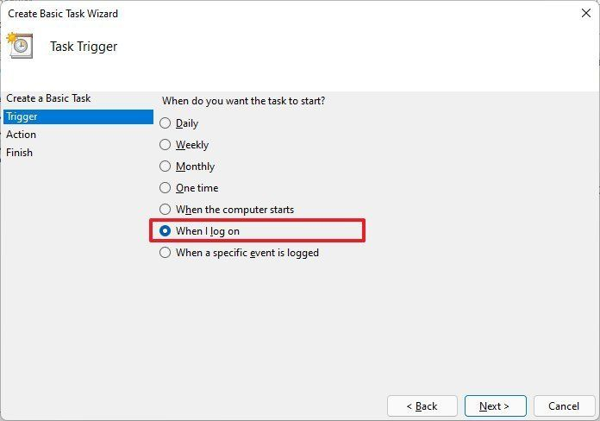
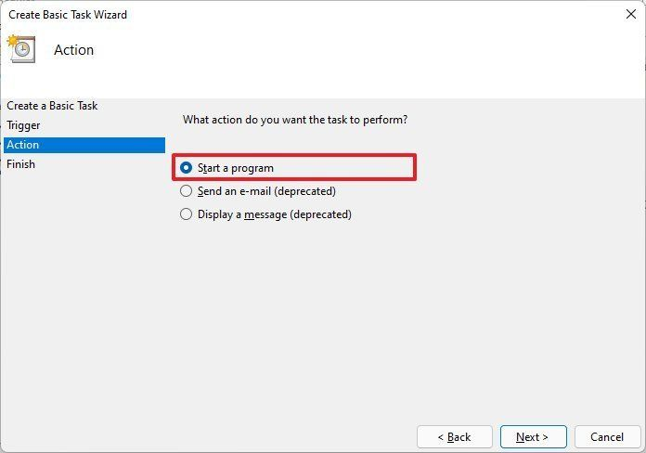
Select the Start a program option.

Slide 15
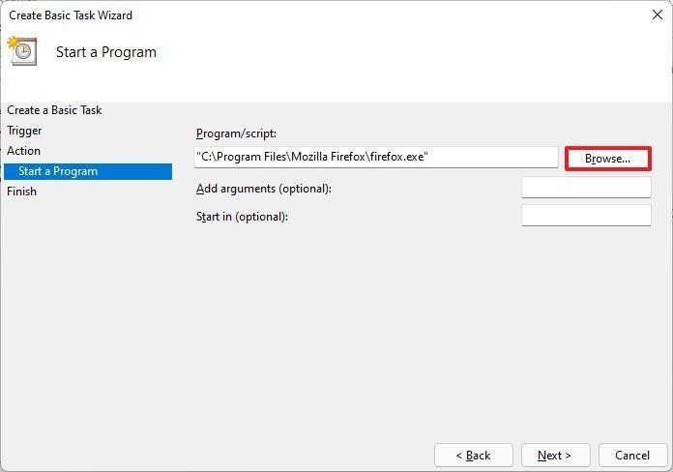
Click the Next option.
Click the Browse button.
Select the app to auto-start
Source: Windows Central (Image credit: Source: Windows Central)
Open the app installation folder.
Select the app executable (.exe) file that launches the program.
Click the Open button.
Click the Next button.
Click the Finish button

Slide 16
Once you complete the steps, the app will launch automatically on Windows 11 every time you sign in.
While there are many ways to launch apps automatically, it's worth pointing out that having too many apps can affect system performance. You should only auto-start those that you need the most. If you have a lot of apps launching at startup, you can use these steps to disable those you don't need.

Slide 17
Thank You!

